Slide 1
CAD/CAM PROJECT WATER COOLER
Harikrishnan.A (1510110148)
Hasan Fayaz.s.m (1510110316)
Raghav Puri (1510110294)
Mohammed azharudeen.f (1510110486)

Slide 2
WATER COOLER
A water cooler or water dispenser is a device that cools and dispenses water
They are generally broken up in two categories: bottle less and bottled water coolers.
Bottle less water coolers are connected to a water supply, while bottled water coolers require delivery (or self-pick-up) of water in large bottles from vendors.

Slide 3
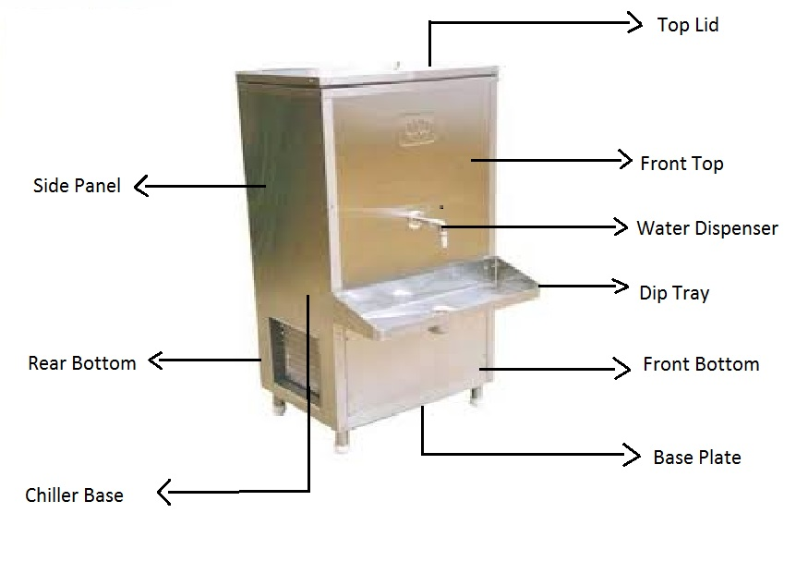

Slide 4
Crucial components of a water cooler
Condenser Coil
Compressor
Motor
Fan
Dryer
Capillary
Thermostat
Float Ball

Slide 5
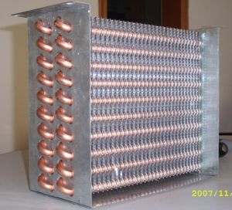
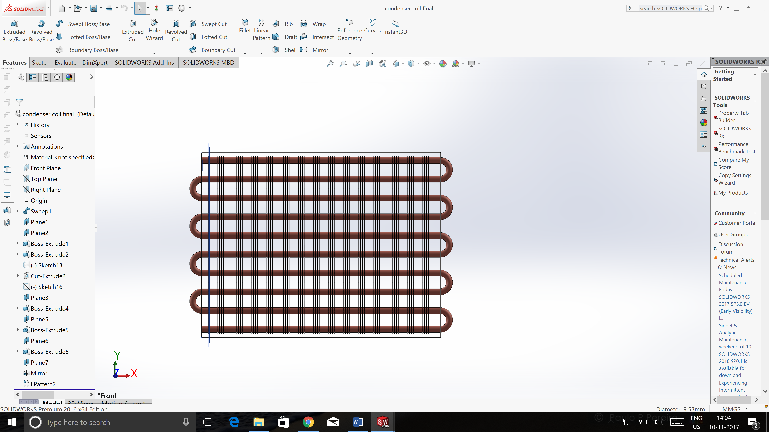
Condenser Coil
Condensers Coils are heat exchangers designed to remove the heat absorbed by the refrigerant and heat of compression added to the refrigerant vapour discharged by the compressor to some external cooling medium, usually water or air.
Original Coil CAD Model

Slide 6
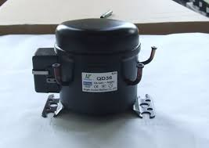
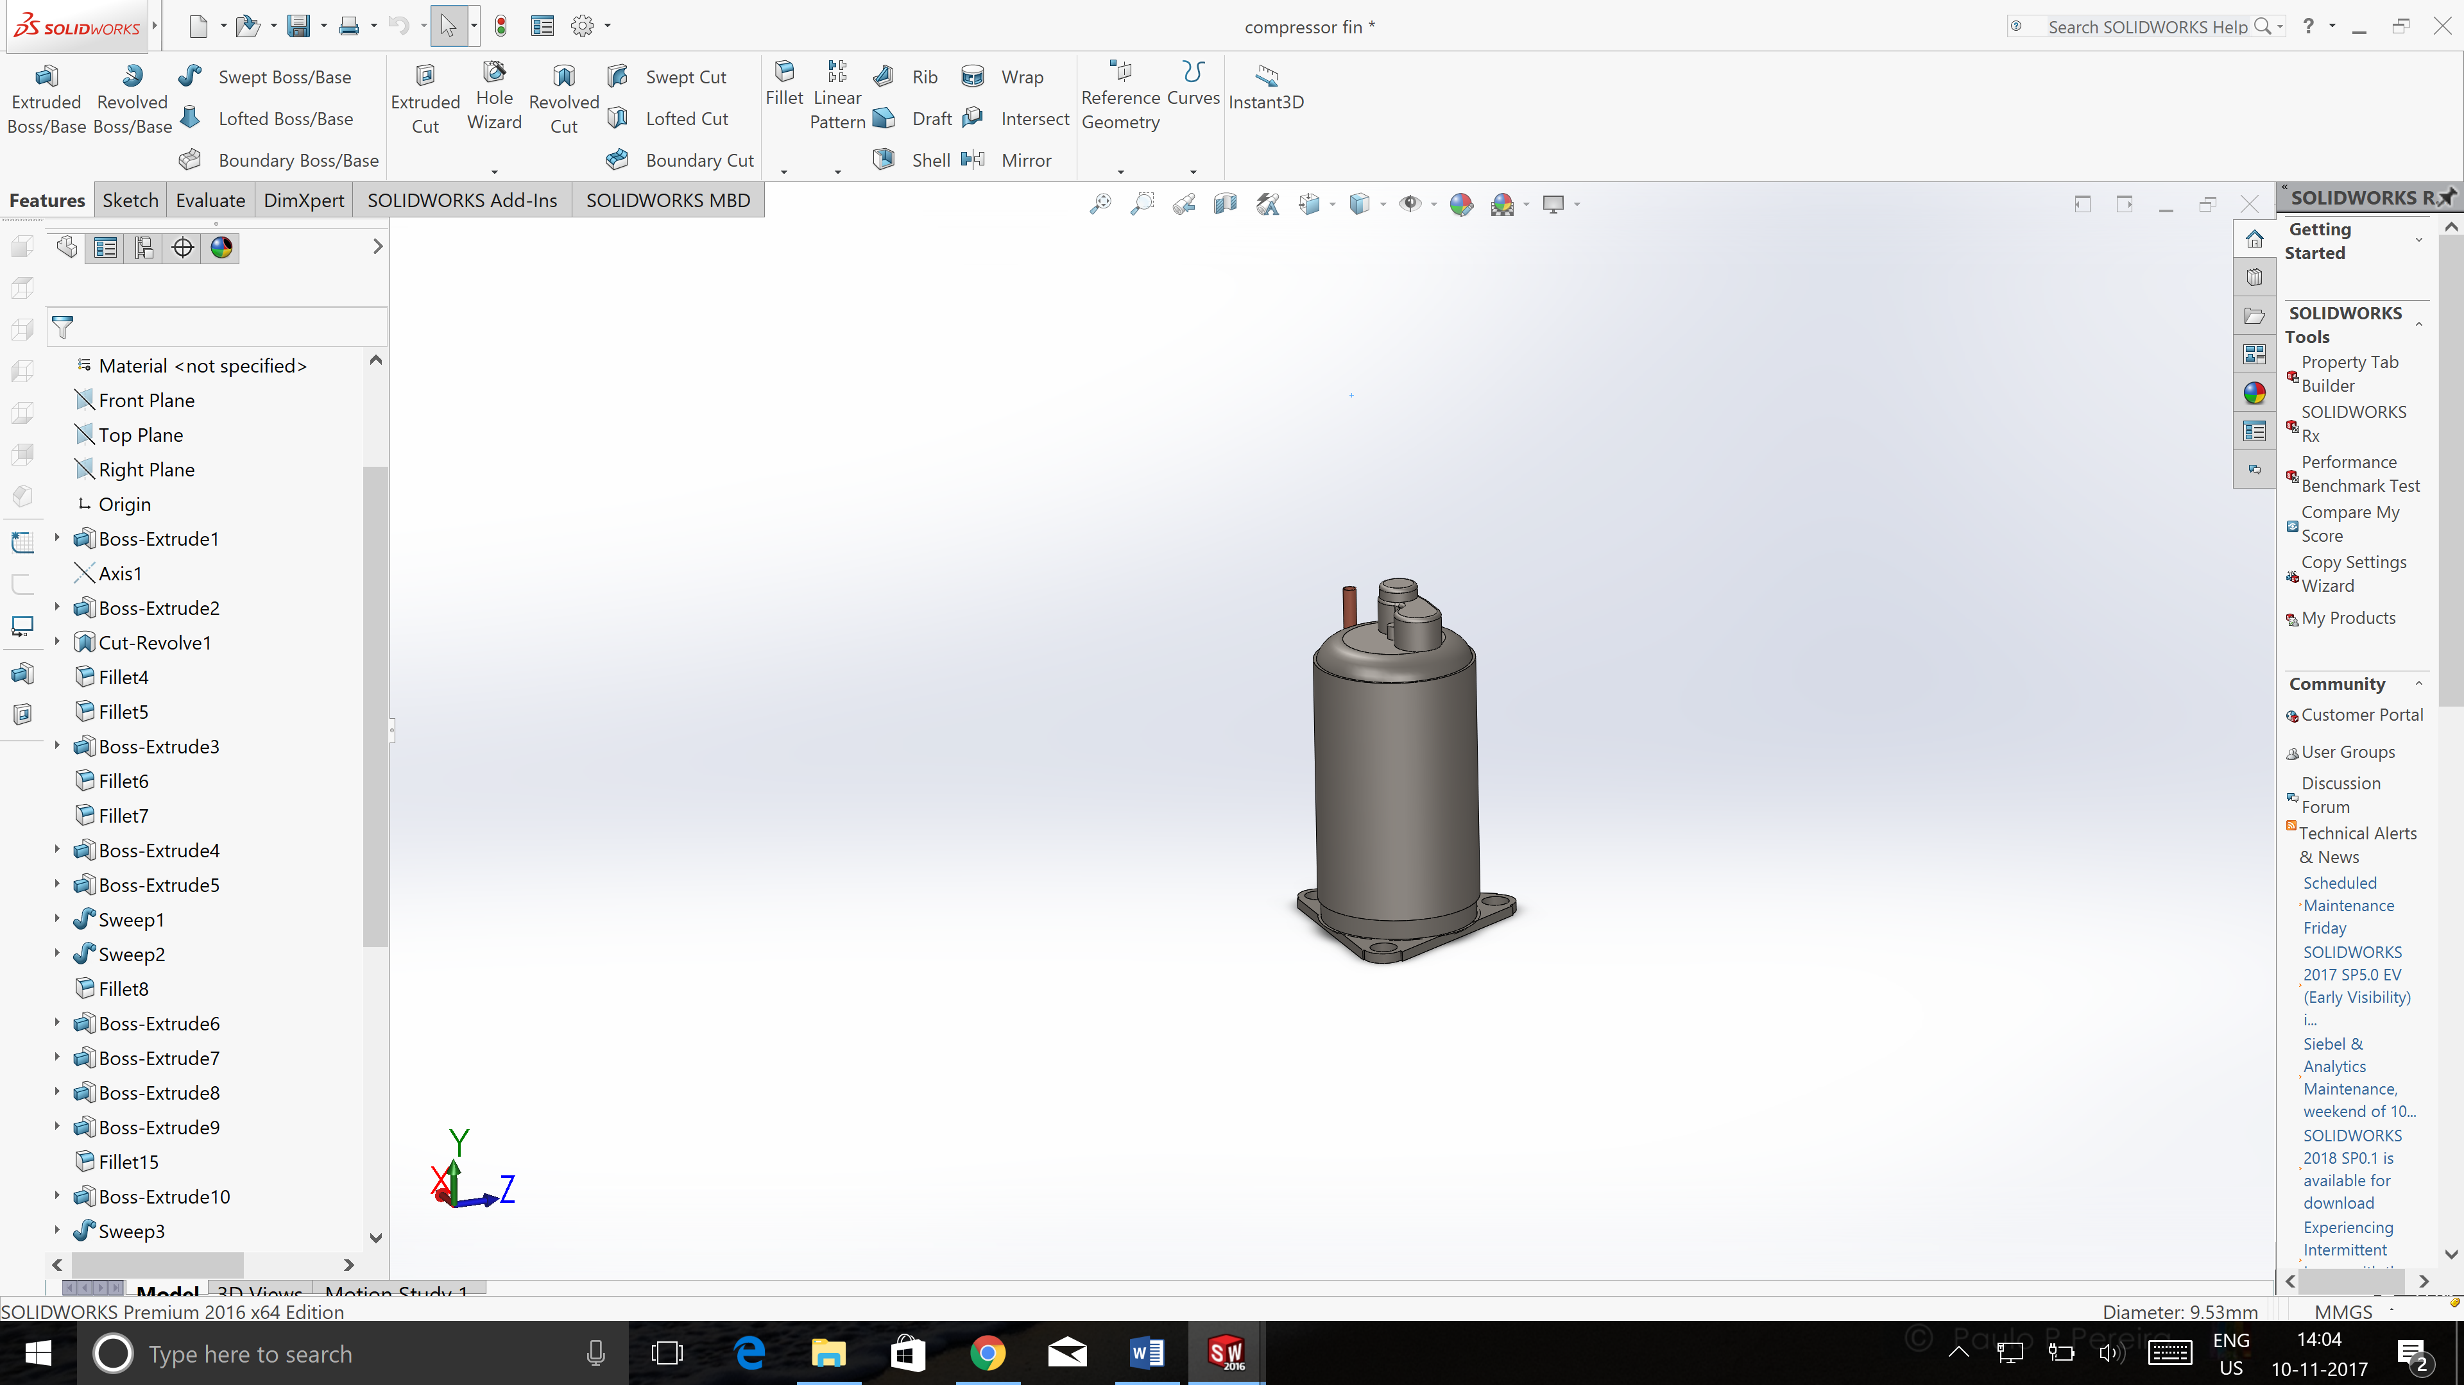
Compressor
A compressor is a mechanical device that increases the pressure of a gas by reducing its volume.
Compressors are similar to pumps: both increase the pressure on a fluid and can transport the fluid through a pipe. As gases are compressible, the compressor also reduces the volume of a gas.
Liquids are relatively incompressible; while some can be compressed, the main action of a pump is to pressurize and transport liquids.
Original Compressor CAD Model of Compressor

Slide 7
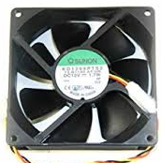
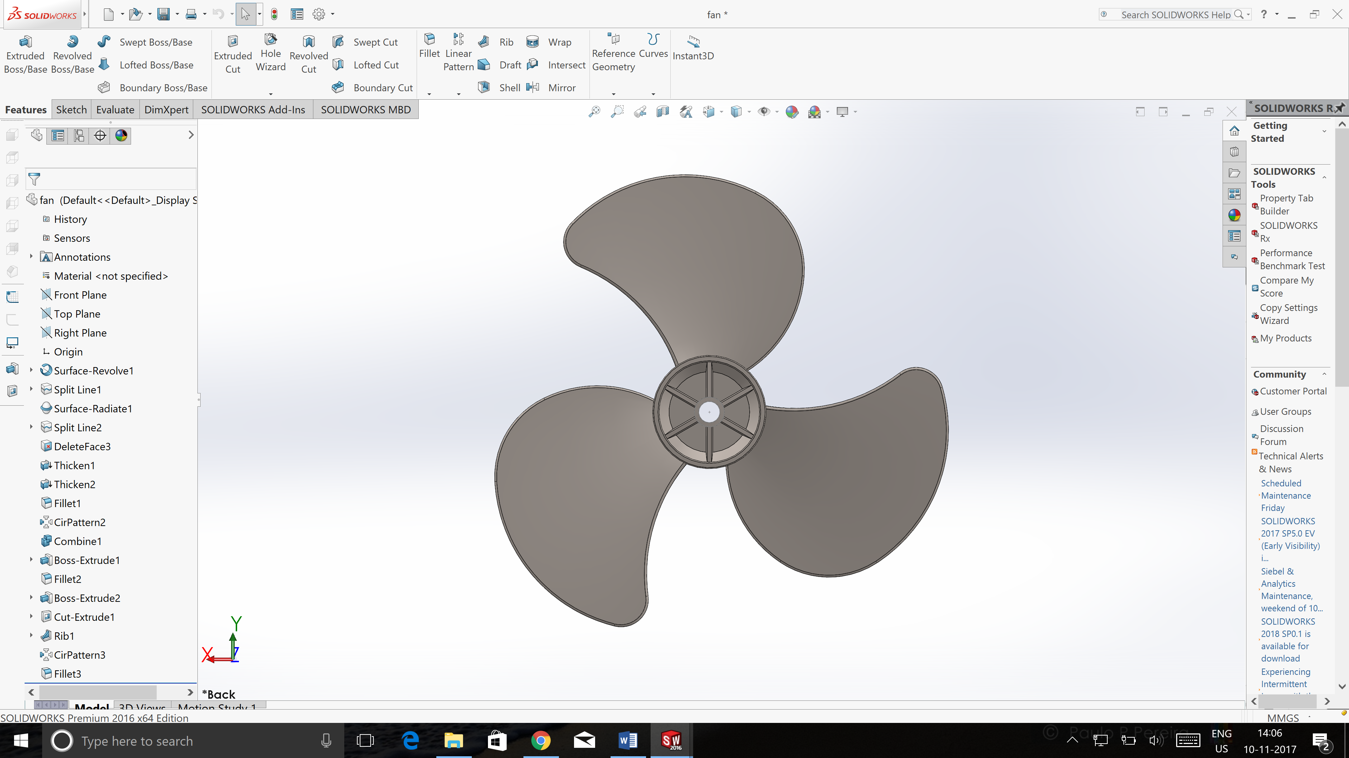
Fan
Fan’s function is to move the air across the condenser coil to cool the refrigerant, and change it from a hot gas into a liquid.
A condenser unit typically has a heat exchanger section to cool down and condense incoming refrigerant vapor into liquid, a compressor to raise the pressure of the refrigerant and move it along, and a fan for blowing outside air through the heat exchanger section to cool the refrigerant inside.
Original Fan CAD Model of Fan

Slide 8
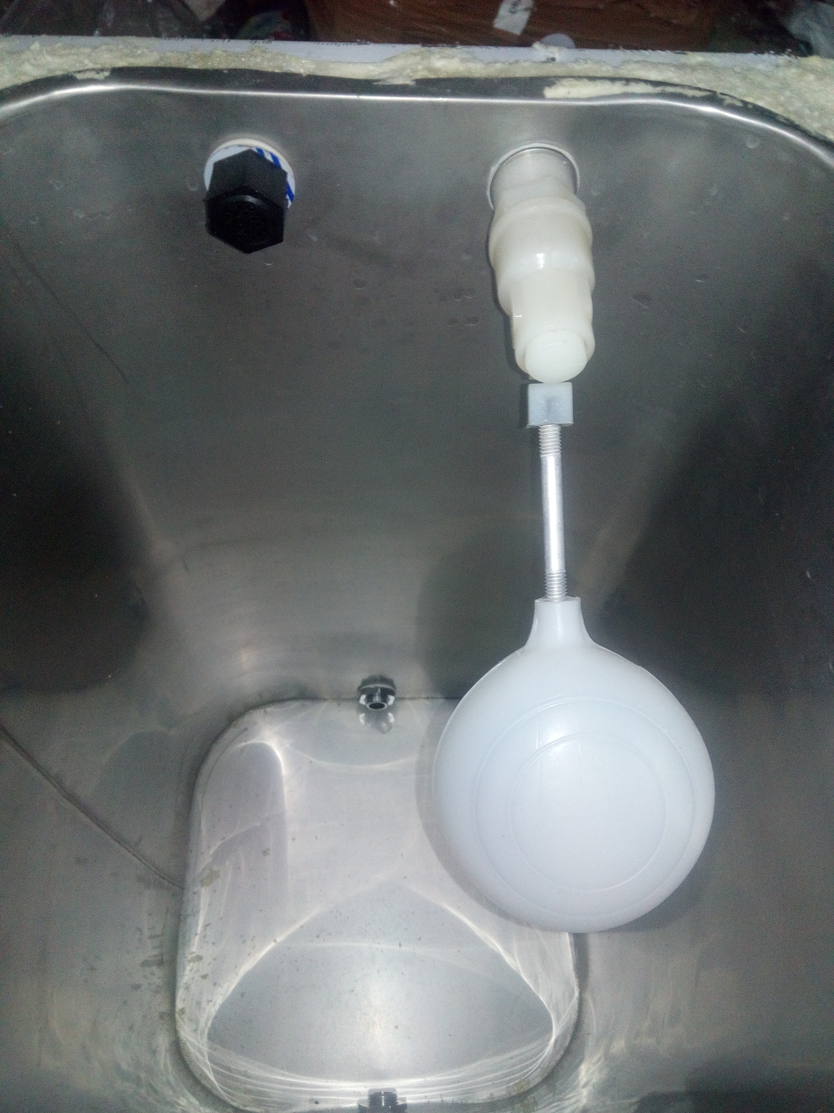
Float Ball
One of the methods used to control the flow of water into water cisterns and tanks is the use of ball (aka float) valves.
Put simply, a float on the water inside a cistern or tank is attached to an arm which operates a valve which controls the inflow of water.
As the water level in the tank drops, the arm falls and opens the valve to allow water to enter the tank.
Then as the water flows in, the water level rises, as does the ball thus moving the arm which then closes the valve shutting off the water flow.

Slide 9
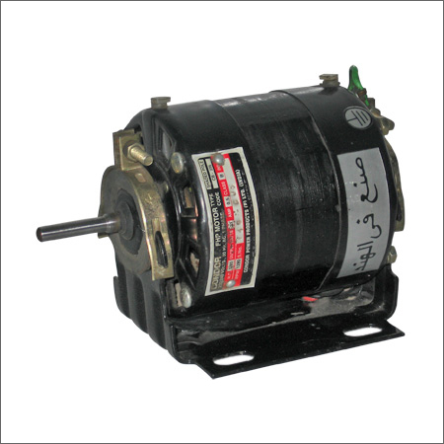
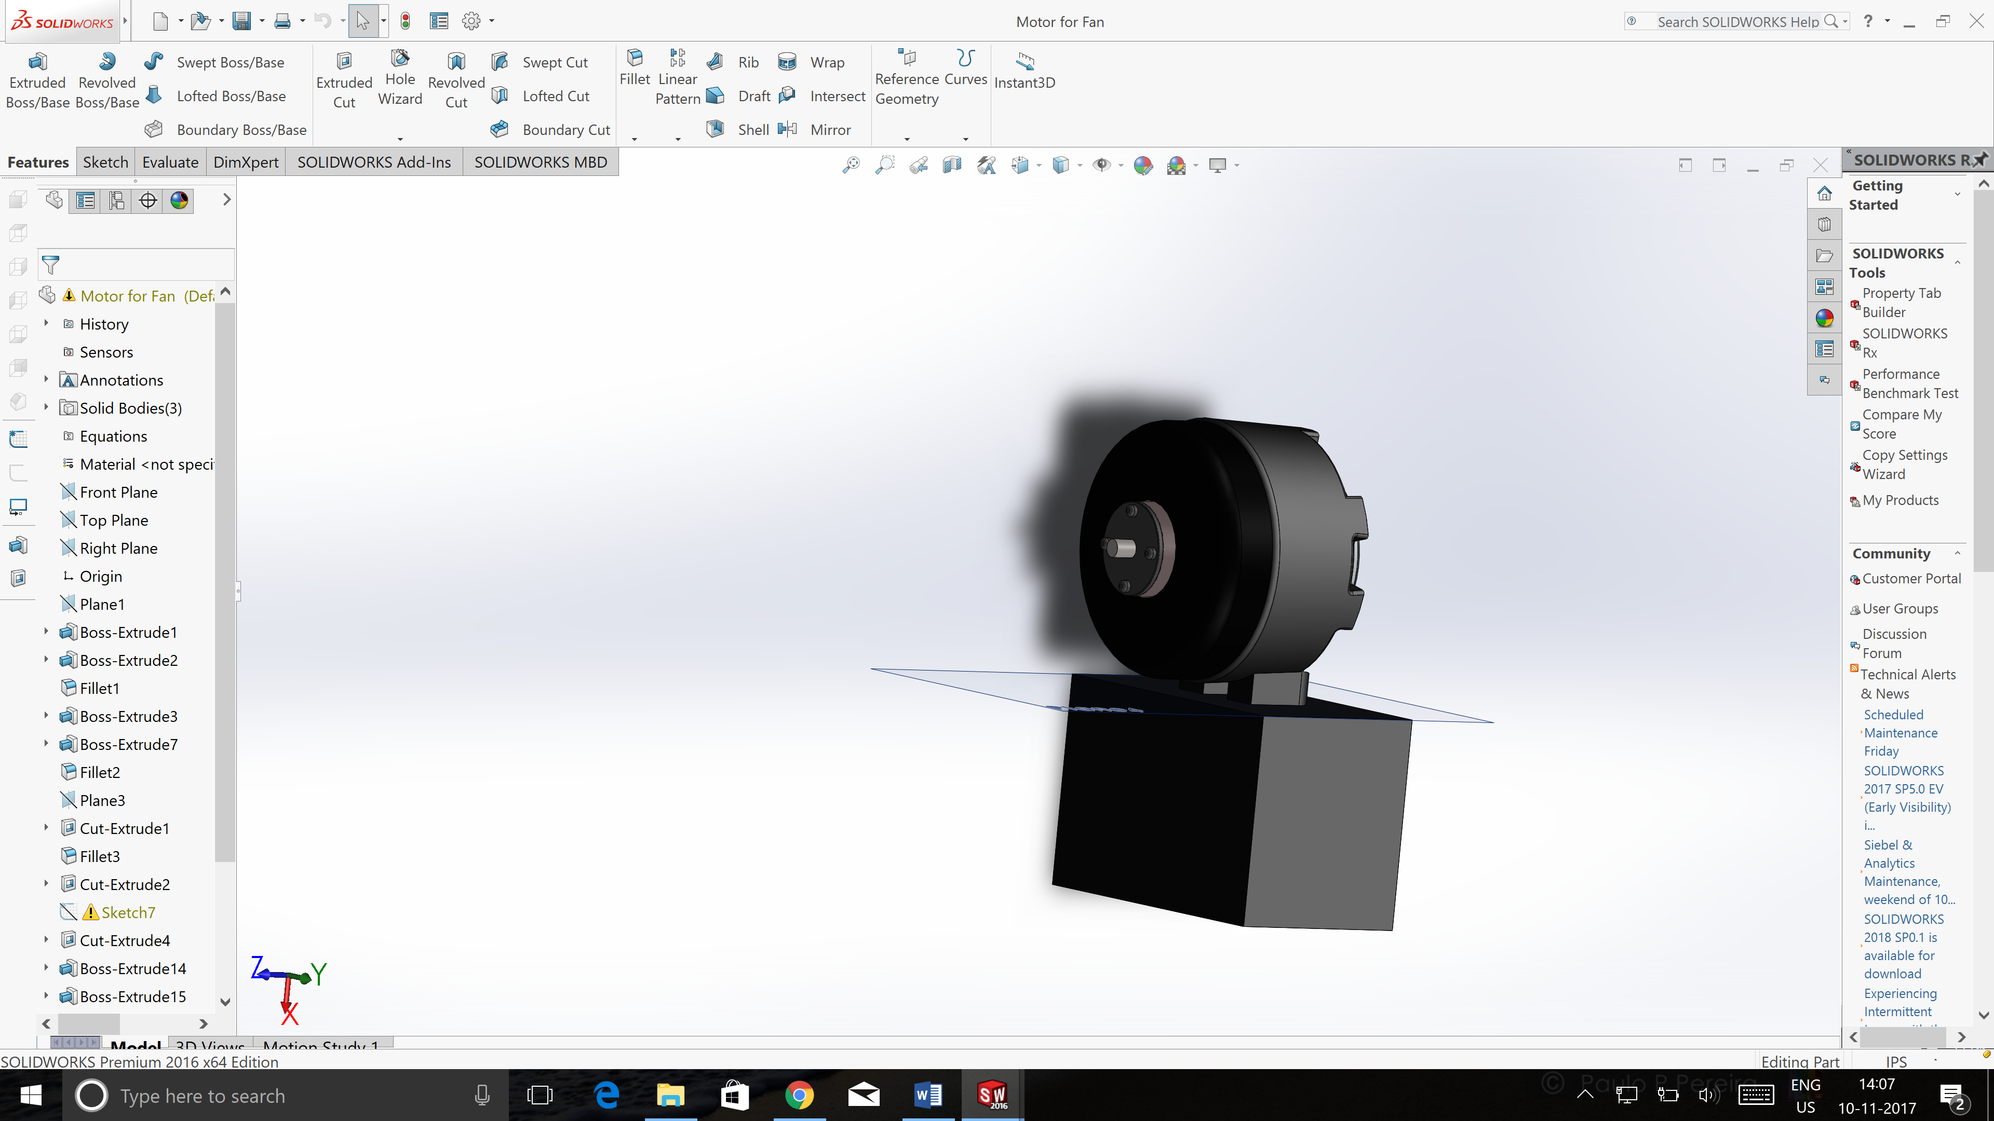
Motor
An electric motor is an electrical machine that converts electrical energy into mechanical energy.
Most electric motors operate through the interaction between an electric motor's magnetic field and winding currents to generate force.
The very basic principal of functioning of an electrical motor lies on the fact that force is experienced in the direction perpendicular to magnetic field and the current, when field and current are made to interact with each other.
Original Motor CAD Model of Motor

Slide 10
Thermostat
A thermostat is a component which senses the temperature of a system so that the system's temperature is maintained near a desired setpoint.
A thermostat simply switches the heating system on and off as necessary.
It works by sensing the air temperature, switching on the heating when the air temperature falls below the thermostat setting, and switching it off once this set temperature has been reached.

Slide 11
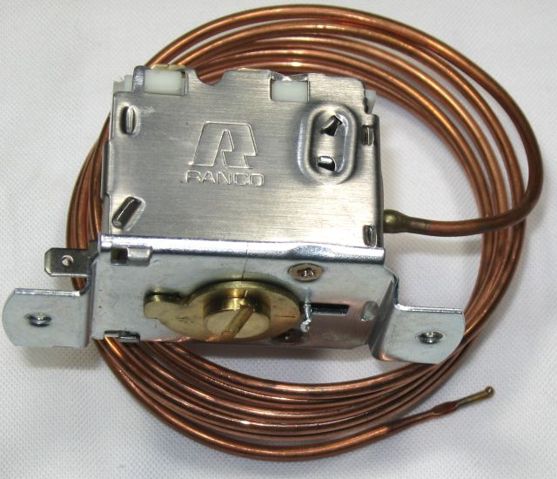
A thermostat can often be the main control unit for a heating or cooling system, in applications ranging from ambient air control, to such as automotive coolant control, but is also used in many other applications
A thermostat exerts control by switching heating or cooling devices on or off, or by regulating the flow of a heat transfer fluid as needed, to maintain the correct temperature. Thermostats are used in any device or system that heats or cools to a set-point temperature.

Slide 12
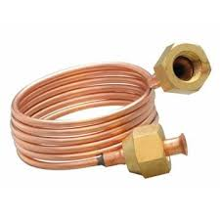
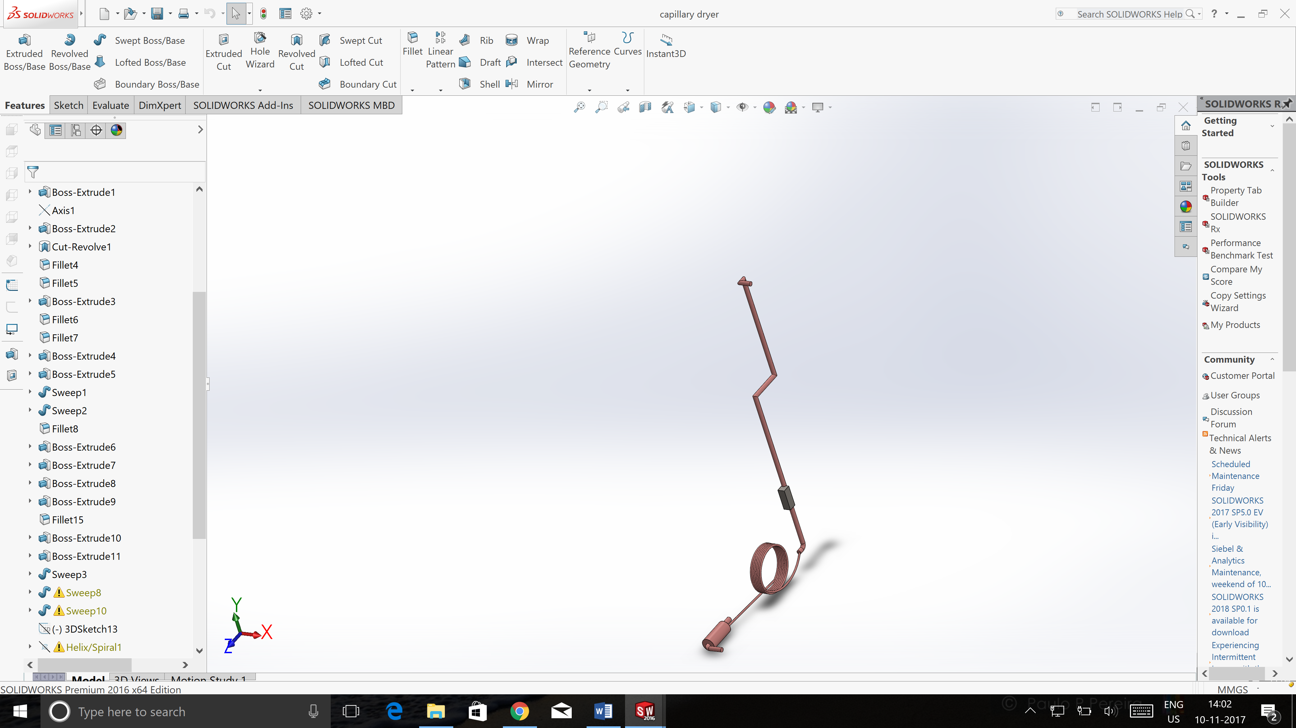
Capillary Tube
A capillary tube is a hollow pipe of thin cross section. It's purpose in the water cooler is to further bring down the temperature of the refrigerant gas. This is caused by the reduction of pressure after the gas flows out of the thin cross sectioned capillary into the larger cross section of the copper tube wound around the tank. The area increase is significant and so is the temperature drop.
Original Capillary Tube CAD Model of Capillary Tube

Slide 13
Specifications of sheet metal used
The structural parts of the water cooler are made of sheet metal of various thickness and materials.
The front top, rear top, side panels, front bottom, rear bottom, dip tray and top lid are made of S.S. grade- 304, thickness- 0.8mm.
The water tank is made of S.S. grade 304, thickness- 0.5mm.
The chiller base’s material is G.P. of thickness 0.5mm.
The base plate made of G.I. has a thickness of 1.5mm.
NOTE : S.S. grade- 304 It has a higher corrosion resistance than regular steel and is widely used because of the ease in which it is formed into various shapes.

Slide 14
Manufacturing of Structural Parts
First, the metal sheets are punched using the CNC machine in order to get the required dimensions and holes in 2-D.
Next, the sheets are bent by the bending machine at various angles to obtain the 3-D structure.
What is a CNC Machine?
Computer numerical control (CNC) is the automation of machine tools by means of computers executing pre-programmed sequences of machine control commands. This is in contrast to machines that are manually controlled by hand wheels or levers, or mechanically automated by cams alone.

Slide 15
Working and Refrigeration Process
The water cooler works on the principle of gas pressure system.
R-22 gas of 900gms flows into the system and cools the tank.
The gas is compressed by the compressor to reach 43.3 degree Celsius at a high pressure and passed through the condenser coil via the discharge pipe.
A fan is used to cool the condenser coil and drop the temperature. The condenser coil condenses the refrigerant gas into a liquid.
The liquefied gas which is then passed through the long capillaries via the dryer (which absorbs all moisture) undergoes high pressure due to extremely thin cross section.

Slide 16
This pressure is reduced by the increase in cross section as the gas flows into the copper coil of the tank. (P=F/A)
The reduction in pressure leads to a sharp drop in the temperature of the R-22 gas (16 degrees). (PV=nRT)
This cold gas passes through the copper coil of the tank and returns to the compressor via the section pipe at a return gas temperature of 18.3 degree Celsius.
This cycle continues and results in the cooling of water inside the tank.
A thermostat, whose capillaries are attached to the tank via the thermostat pipe senses the temperature and regulates it according to our need.

Slide 17
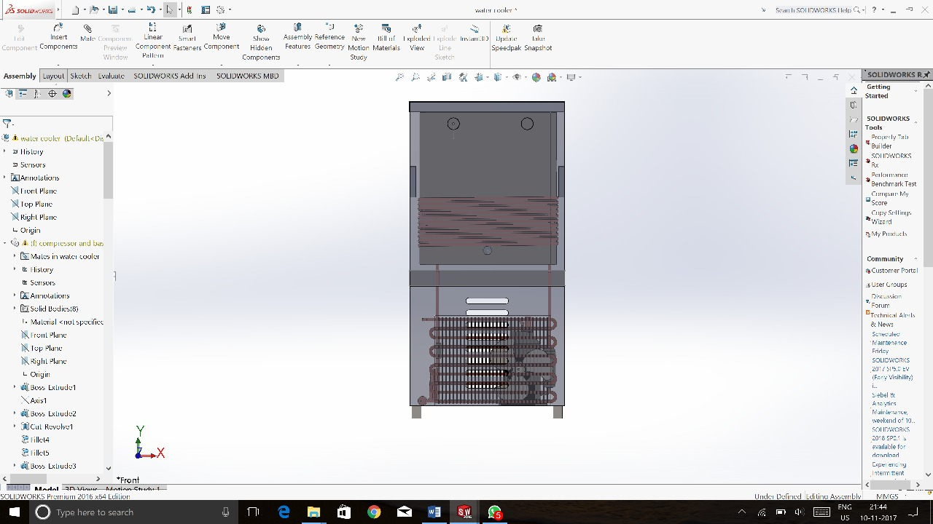
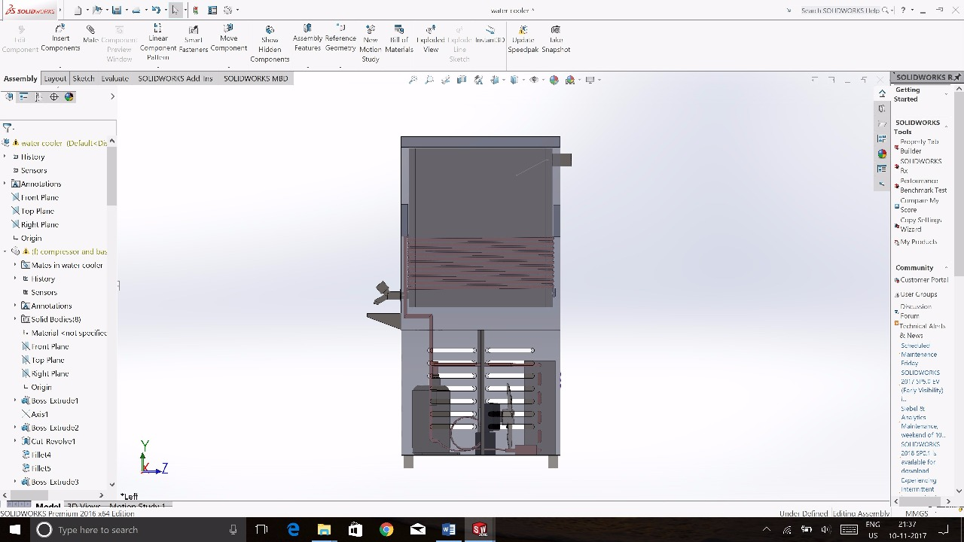
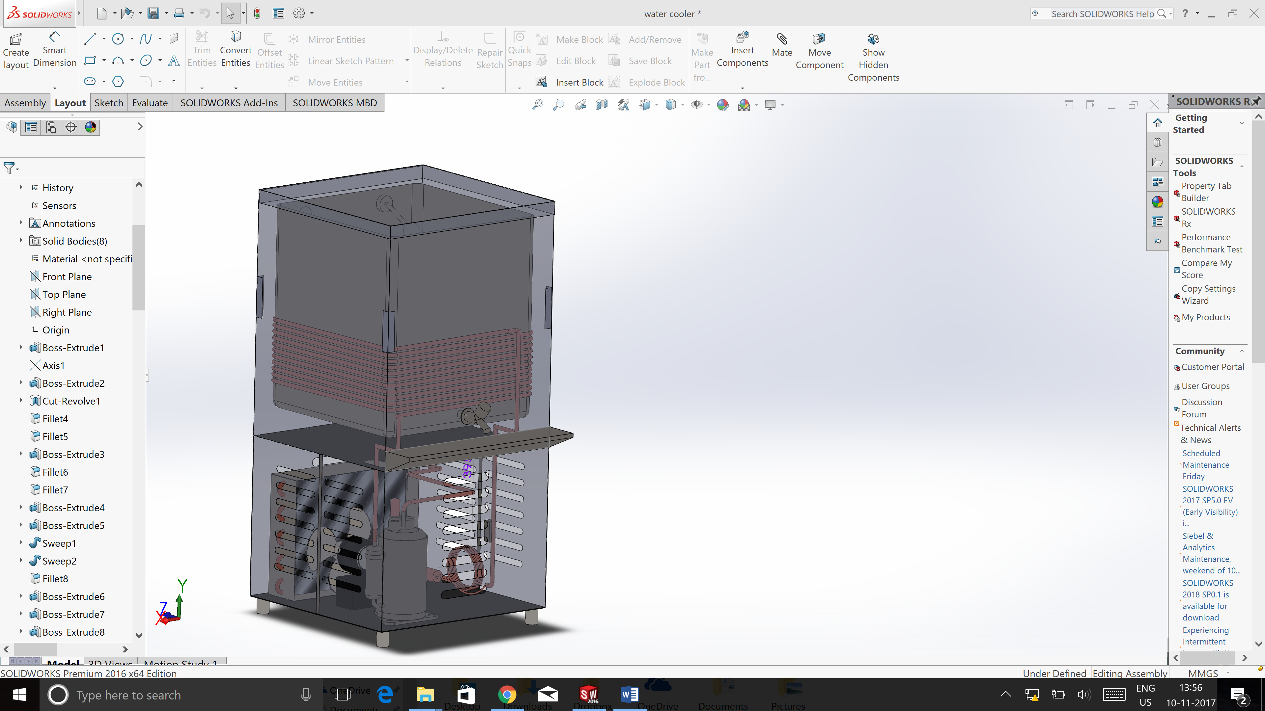
CAD Model

